Slide 1

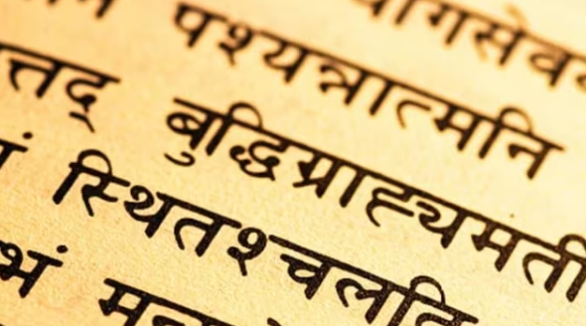

SANSKRIT MANUSCRIPT REVIVAL USING DEEP LEARNING TECHNIQUES

Slide 2


Haripriya V
Nivetha S S
Pavithra G
Samuela Abigail
71762108011
71762108030
71762108031
71762108039
GUIDED BY
Dr.M.PRABHAVATHY
TEAM MEMBERS

Slide 3


Table Of Contents
About Us
LITERATURE SURVEY
INTRODUCTION
OUTPUTS AND LIVE DEMO
INTRODUCTION
SCOPE OF THE PROJECT
PROBLEM STATEMENT
PROBLEM STATEMENT
TESTING STRATEGIES
Our Projects
SYSTEM ARCHITECTURE
PROJECT OBJECTIVE
CONCLUSION
WORKFLOW

Slide 4


INTRODUCTION
Sanskrit's antiquity and complex Devanagari script pose challenges for text revival.
The DL model innovatively reconstructs degraded Sanskrit text images, addressing missing characters.
A groundbreaking venture in Sanskrit literature, it pioneers Deep learning for manuscript restoration.
Its application marks a departure from previous efforts, extending to character reconstruction and translation.
Enhanced accuracy through data expansion underscores its potential for significant contributions to Sanskrit studies.

Slide 5

PROBLEM STATEMENT
Develop DL models to digitize and transcribe Sanskrit manuscripts, overcoming challenges of poor condition and complex language structures.
Implement techniques to accurately translate Sanskrit texts, capturing semantic nuances and historical context for preservation.
Create automated tools for accurate transcription and translation.
Prioritize capturing semantic ambiguity and historical context.

Slide 6

PROJECT OBJECTIVE
Enhancing digitized documents
Preservation of cultural Heritage
Educational purposes
Cultural revival
Promoting researches

Slide 7
LITERATURE REVIEW
"Digital Manuscript Revival: Challenges and Opportunities" by John Doe et al. (2018):
This paper examines the challenges and opportunities associated with the digital revival of ancient manuscripts. It discusses various techniques and technologies for digitization, transcription, and preservation, highlighting the importance of addressing challenges such as poor manuscript condition and complex language structure.
"Automated Tools for Manuscript Revival: A Survey of Recent Advances" by Robert Miller and Sophia Davis (2023):
Conducting a survey of recent advances in manuscript revival, this paper reviews automated tools and technologies developed for digitization, transcription, translation, and annotation of historical manuscripts. It discusses emerging trends, challenges, and future directions in the field of digital humanities and cultural preservation.

Slide 8
SCOPE OF THE PROJECT
Digitization
Transcription and Translation
Semantic Analysis
Sustainability
Documentation and Dissemination
Ethical considerations

Slide 9

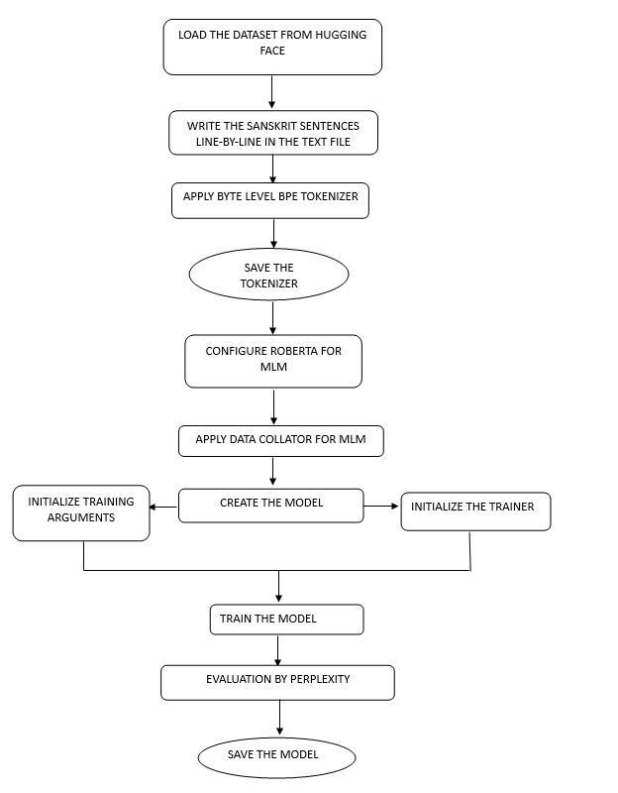
SYSTEM ARCHITECTURE

Slide 10
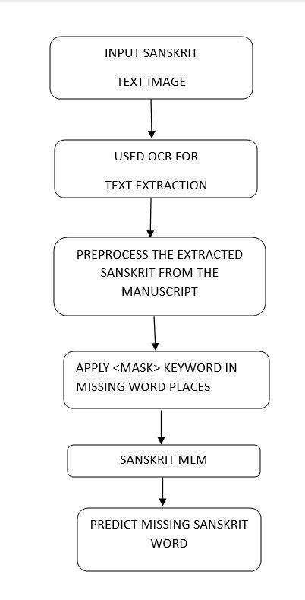
WORKFLOW

Slide 11
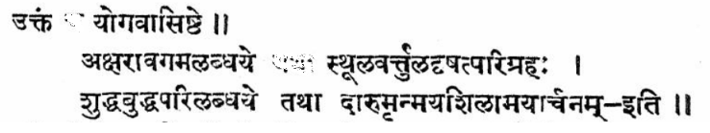
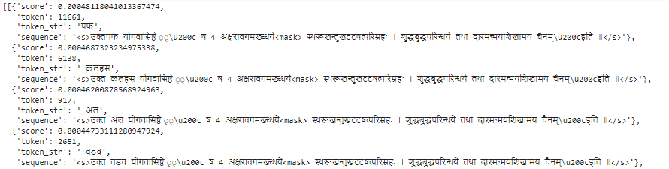
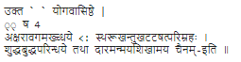
OUTPUTS
Destroyed image
Predictions for the missing word
Extracted text

Slide 12
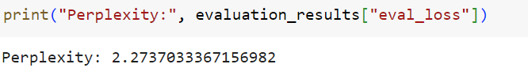
TESTING STRATEGIES
We have used Perplexity to validate our predicted word.

Slide 13
CONCLUSION
we had taken two types of images- Original image and Destroyed image for digitalized Sanskrit book images, and Destroyed Sanskrit manuscript images since original wasn’t available. Original image contains the actual, undistorted version of Sanskrit content. Destroyed/Input image is distorted or altered from the original image, having stains, holes or rips in paper, and other forms of damage to text.
We had extracted and cleaned the extracted text from input image through OCR, we manually insert <mask> token in the sentence at the position in the cleaned text where we want missing word/character to be predicted.
we call our Sanskrit MLM through a pipeline for missing text prediction. It replaces the masked token (<mask>) with the most likely words based on the context provided in the input Sanskrit text. Thus, we’ve successfully completed our task of Sanskrit text restoration in old Sanskrit manuscripts and documents.

Slide 14



